Slide 1
腦電波檢傷分類AI用於心停病患 EEG AI Triage for Cardiac Arrest

Slide 2
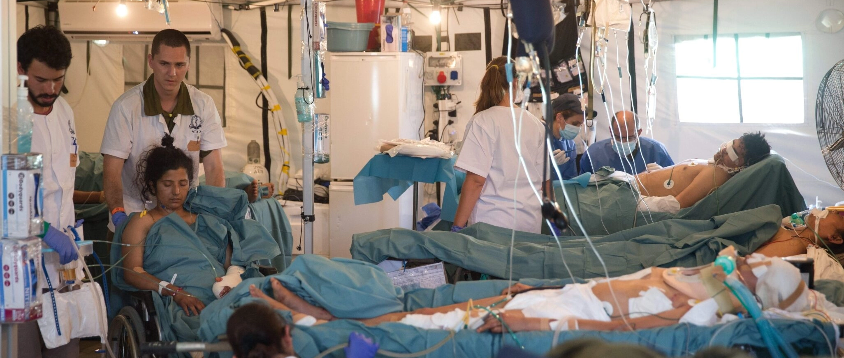
ED crowding : EEG AI triage could find those patients might recover

Slide 3
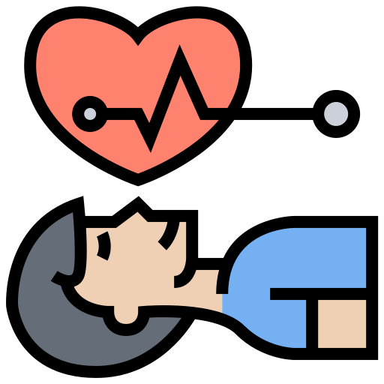
Smart emergency department
Need treatments:
CPR & others
ROSC
Cardiac arrest Patients
Expired

Slide 4
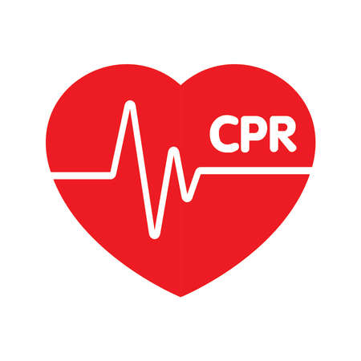
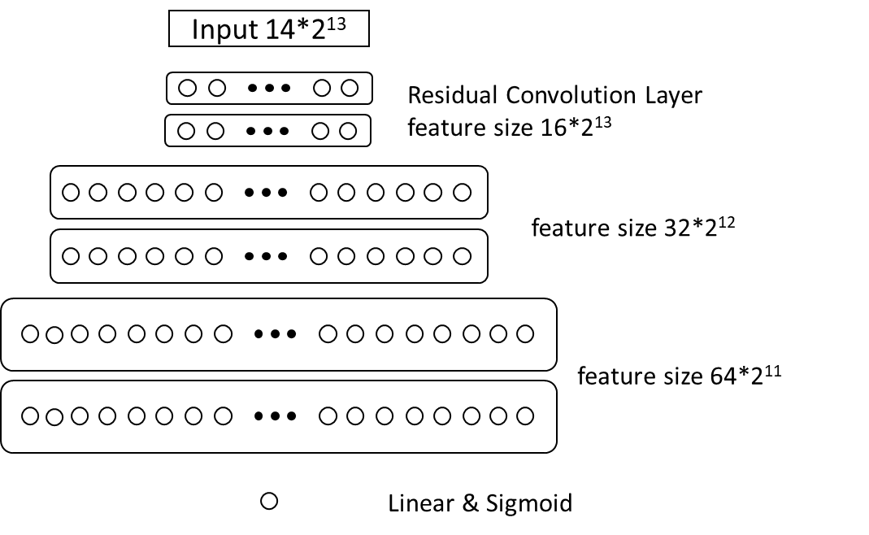
conscious
or
Time
Arrival
Discharge
EEG Generative AI: 305 patients
93 Good
CS code = 1,2
CPC = 1, 2
Glasgow Coma Scale = M6
212 bad: death
Testing: 0.78

Slide 5
Boston HQ
VIZURO LLC
2 Burlington Woods Dr. Suite 100
Burlington, MA 01803
Taipei Office
VIZURO TAIWAN
116 Zhongxiao E. Rd. Sec 2. Suite 501
Taipei. Taiwan 100
www.vizuro.com
Contact
Boston Yu-Feng Wei, PhD
ywei@vizuro.com
Taipei
Ting-Yuan Wang, PhD
ting-yuan.wang@vizuro.com
Confidential. Copyright© Vizuro LLC 2022

